Slide 1
Predicting Solubility of Small Organic Molecules Using Melting Points Dataset
Grace Nye

Slide 2
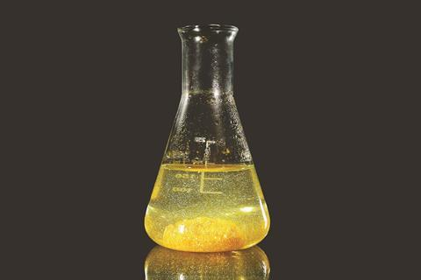
Solubility
Essential to know for drug characterization
Experimental methods are not high-throughput
Existing datasets are small and highly variable…

Slide 3
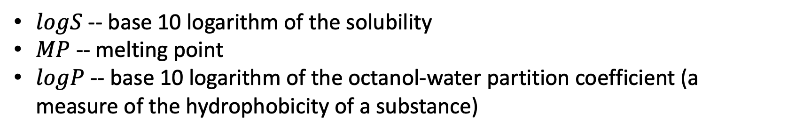
General Solubility Equation
$$logS=0.5 −0.01∗\left(MP −25\right)−logP$$
$logS$ -- base 10 logarithm of the solubility
$MP$ -- melting point
$logP$ -- base 10 logarithm of the octanol-water partition coefficient (a measure of the hydrophobicity of a substance)

Slide 4
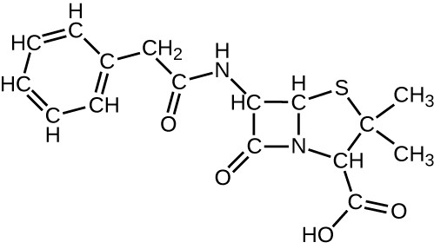
Melting Point Dataset
Cambridge Crystallographic Data Centre
58810 molecules with melting point data
2D molecular descriptors
RDKit.Chem.Descriptors
Calculated from the chemical structure
Molecular weight, aromaticity, hydrophobicity, etc.

Slide 5
External Validation Datasets
Dataset 1 – 72 small molecule drugs
Dataset 2 – 132 compounds from solubility challenge
Dataset 3 – 148 compounds from Ran & Yalkowsky (2001)
Dataset 4 – 900 compounds
Dataset 5 – 8613 compounds curated from AqSolDB
Dataset 6 – 21 proteolysis targeting chimeric (PROTAC) compounds

Slide 6
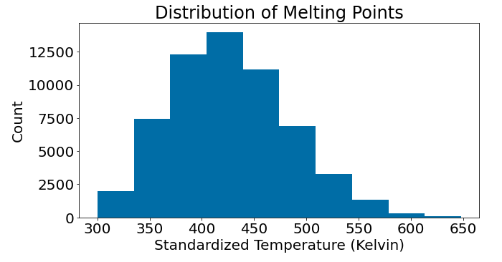
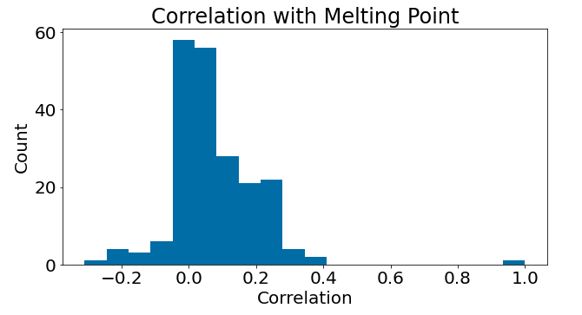
Melting Point Dataset
Fairly normal distribution of melting points
No clear linear relationship between any features
Most strongly correlated with RingCount – a measure of stability

Slide 7
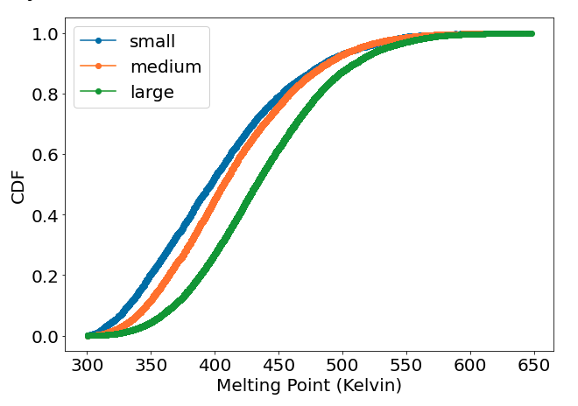
Melting Point & Molecule Size

Slide 8
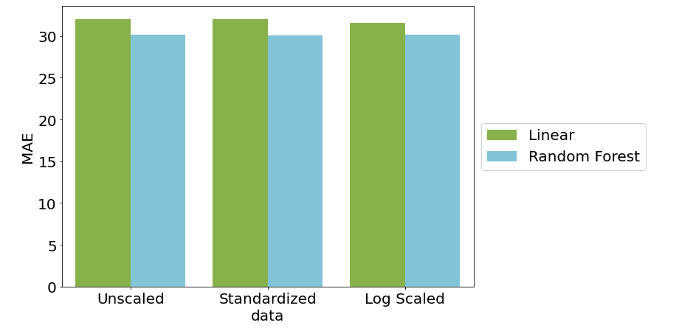
Modeling

Slide 9
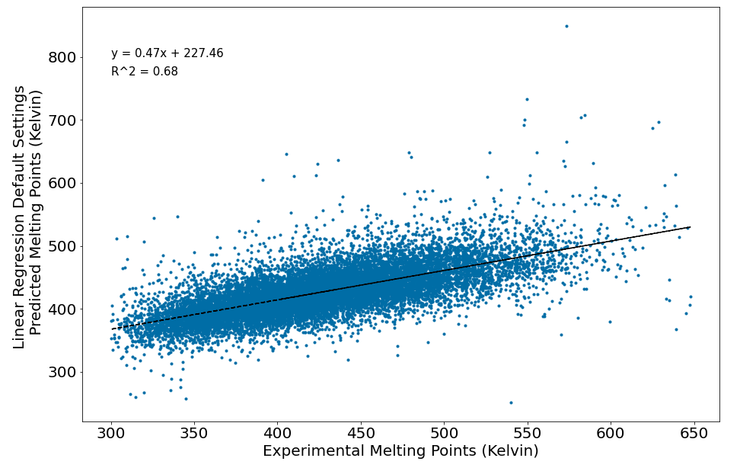
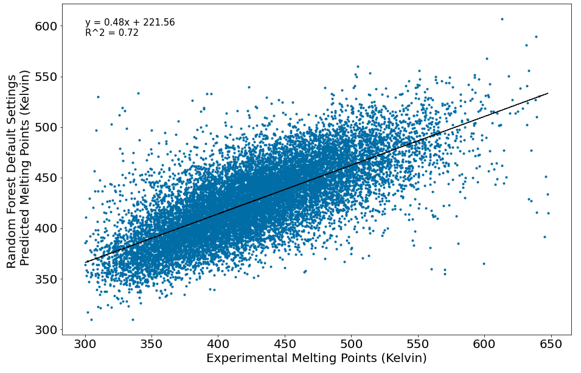
Modeling
Linear Regression
(default settings)
Random Forest Regressor
(default settings)
R² = 0.68
RMSE = 41.45
MAE = 31.97
R² = 0.72
RMSE = 39.31
MAE = 30.08

Slide 10
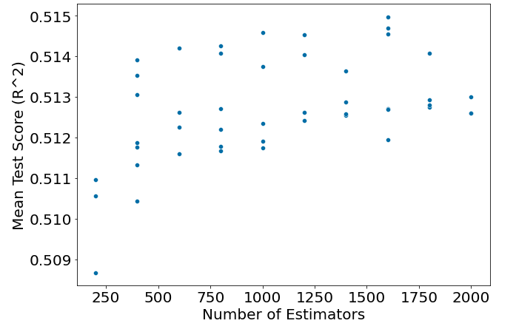
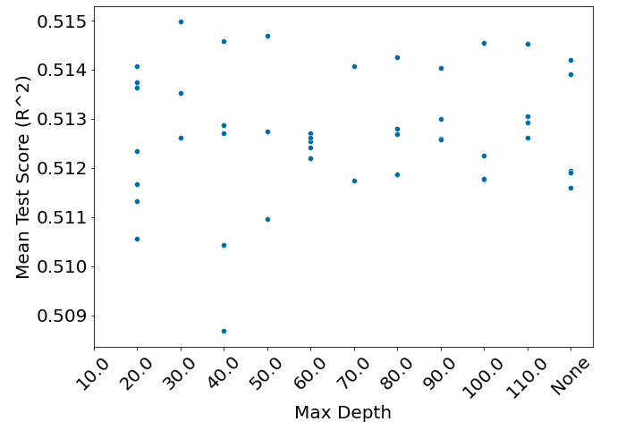
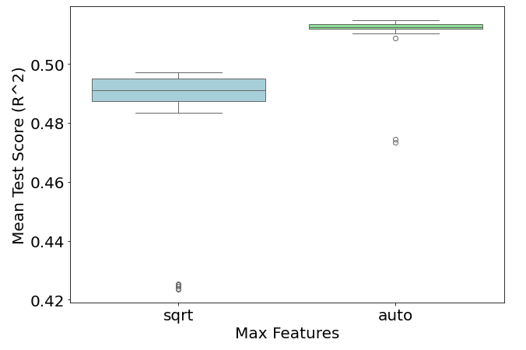
Parameter/Hyperparameter Tuning
sklearn.model_selection.RandomizedSearchCV

Slide 11
Best Model Performance on Melting Points
Parameters/Hyperparameters:
n_estimators = 1600
min_samples_split = 2
min_samples_leaf = 1
max_features = ‘auto’
max_depth=30

Slide 12
Best Model Performance on Solubility

Slide 13
Molecule Size and Model Performance

Slide 14
Conclusion
Can predict melting points for molecules with MAE of ~30K
Can predict base 10 logarithm of solubility with MAE of
Model performs better on alsdkfj size molecules

Slide 15
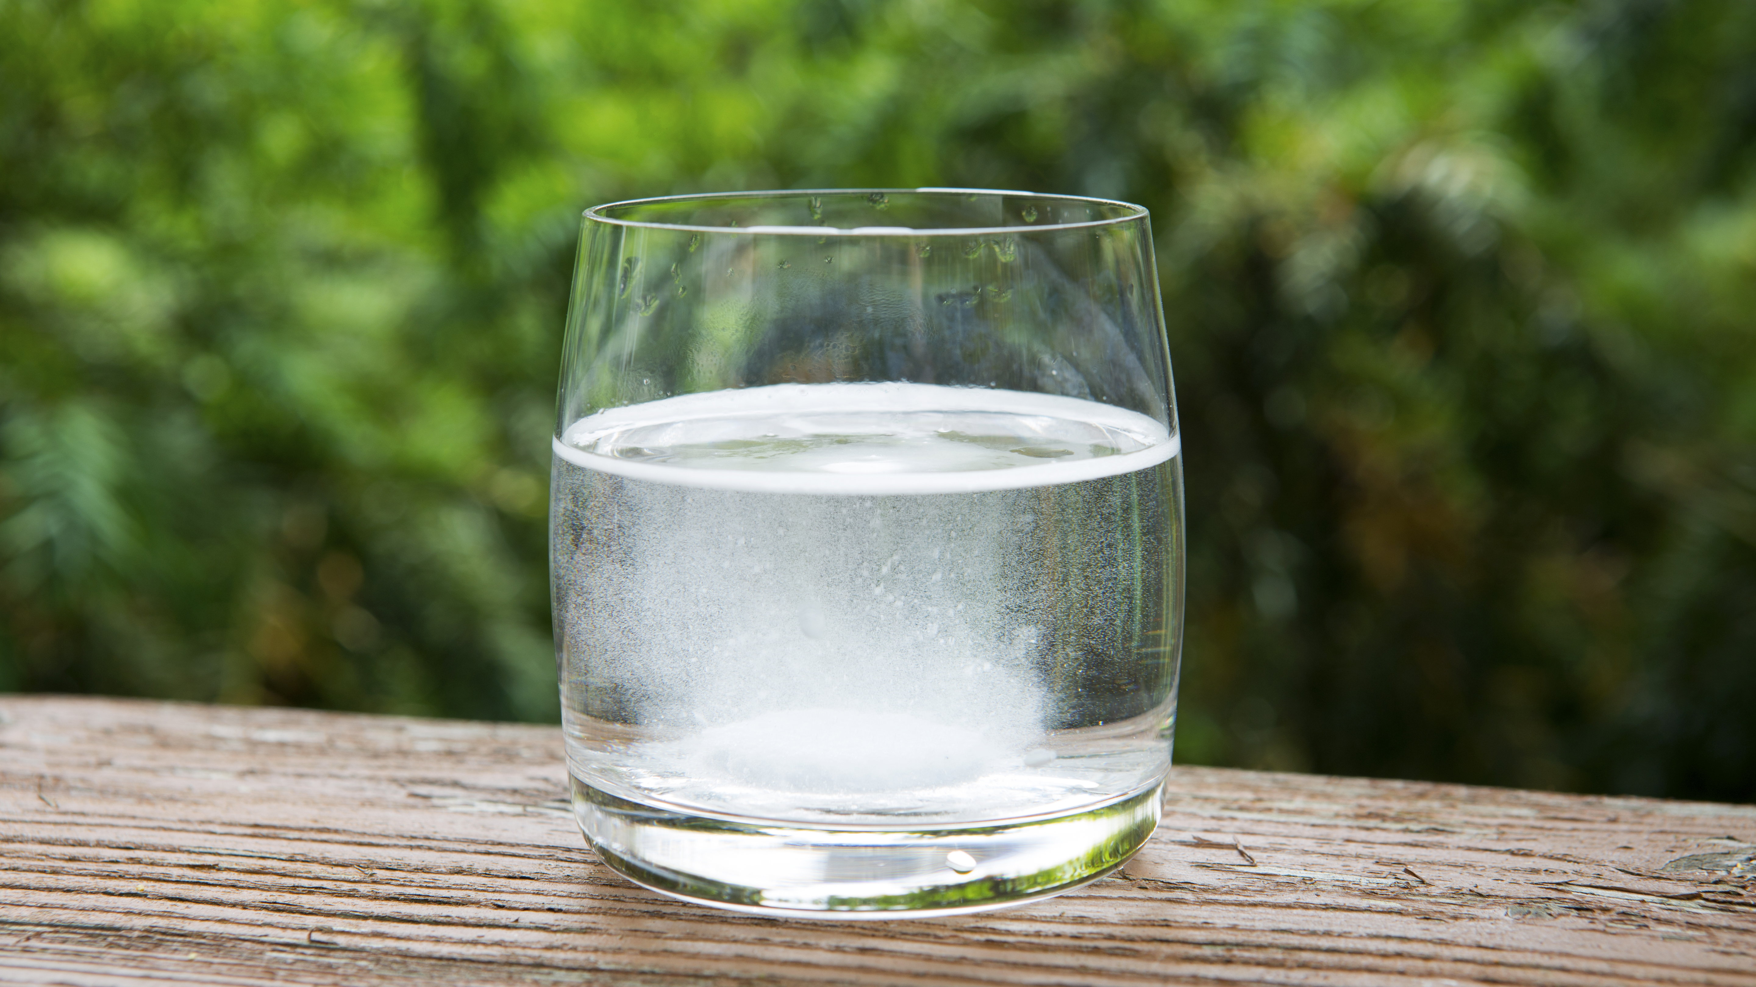
Future Directions
Building a model that goes straight to solubility using the ESOL dataset and 2D molecular descriptors?
Building a model with AqSolDB?
Lack of direct solubility data is a limiting factor – might find that model performance is worse since these datasets are small and varied

